Slide 1

DEMOCRATIC BACKSLIDING
Introduction to international Relations
Mentor: Keita Omi
Presented by: Sakshi Shrivastava

Slide 2
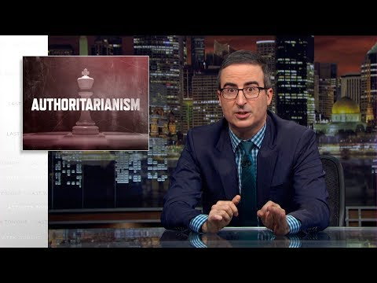
John Oliver notes three characteristics of authoritarian leaders:
1. Dismantling institutions
2. Demonizing enemies
3. Displaying force on a grand scale

Slide 3
What is democratic BACKsliding?
Some definitions that are used:
Decay of democratic characteristics possessed by a government.
Decay of institutions that affect arenas of democracy.
Democratic backsliding also may be formal (e.g. in the form of laws) as well as informal (generally acting contrary to institutional norms).

Slide 4
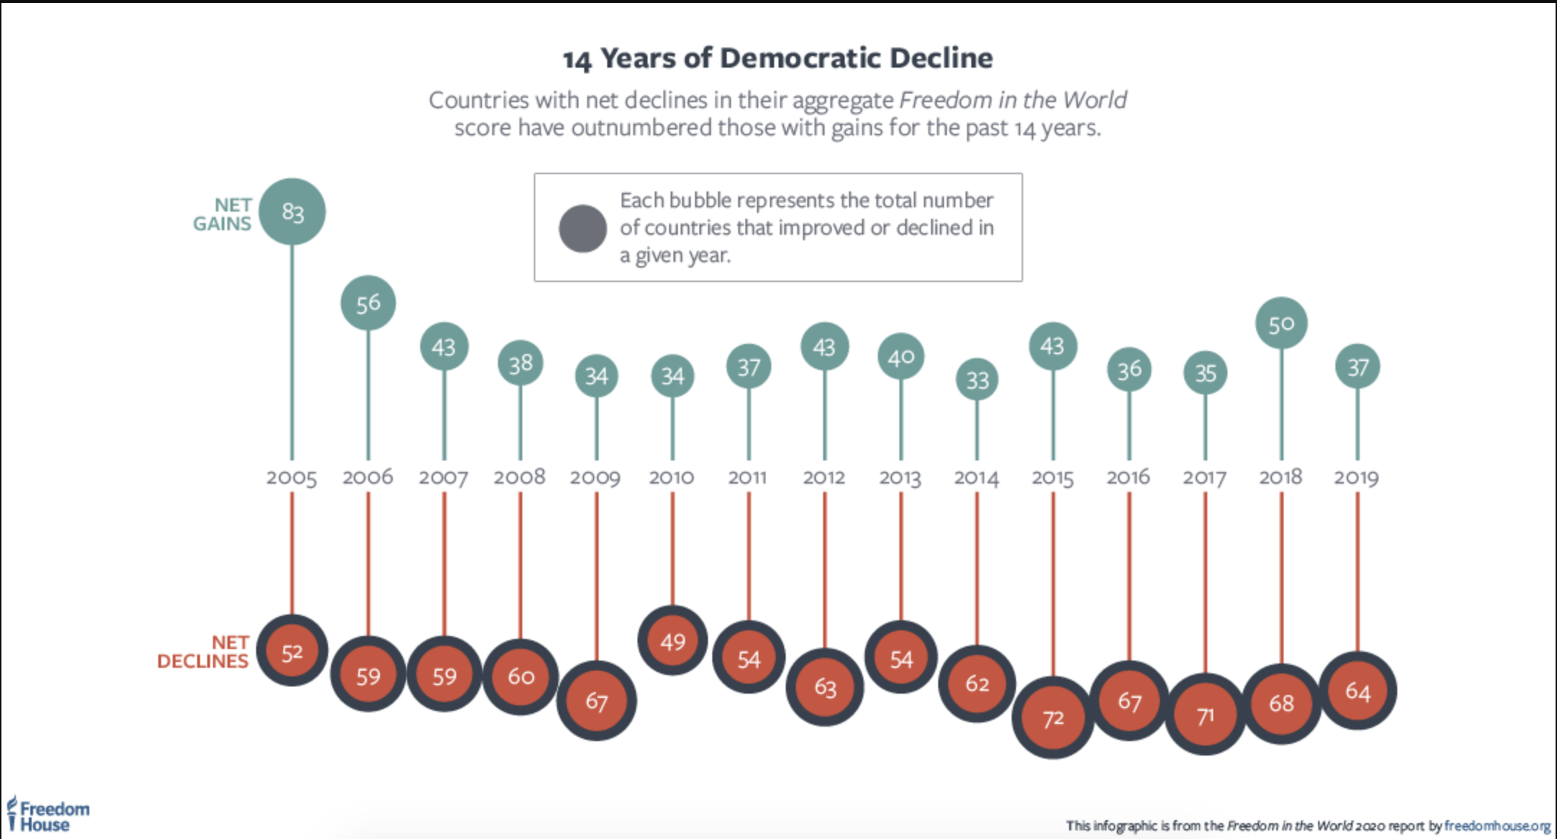

Slide 5
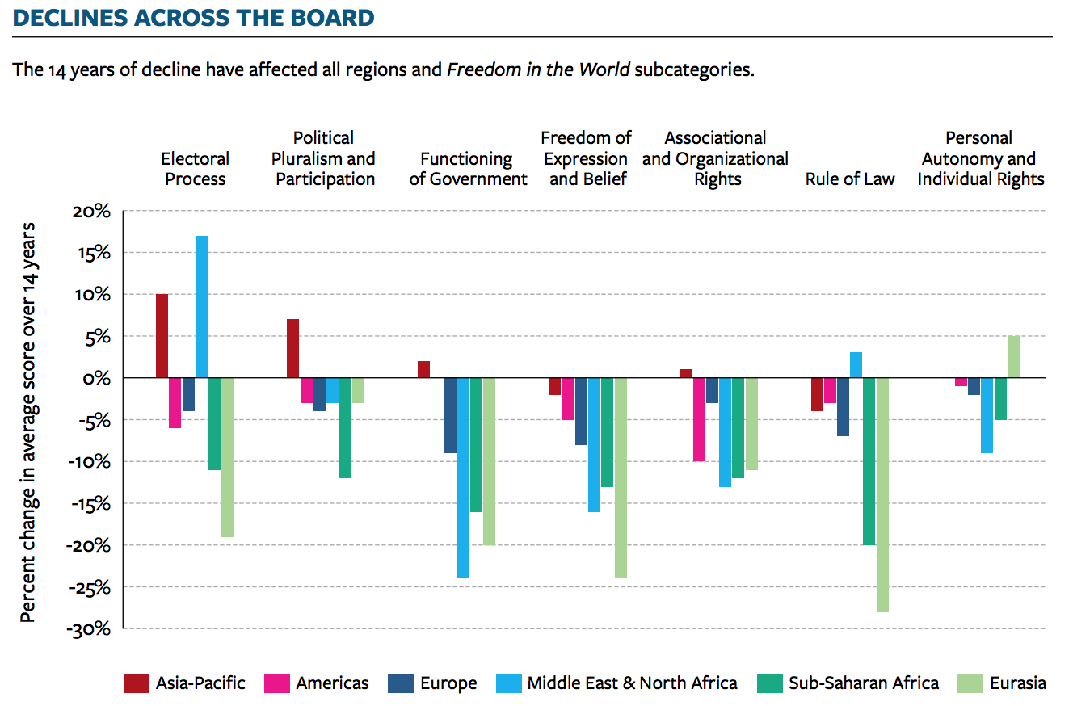

Slide 6
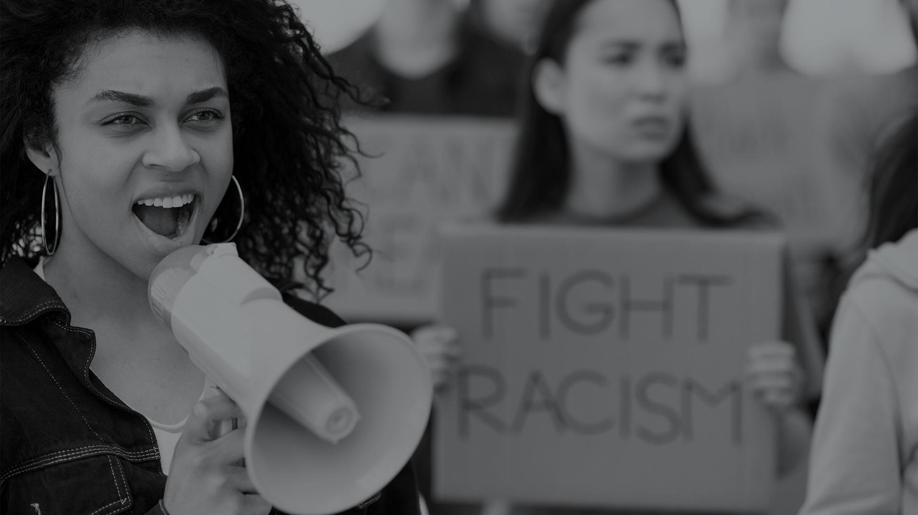
But Backsliding isn’t reversion to autocracy
Unwelcome Change: Coming to Terms with Democratic Backsliding
David Waldner and Ellen Lust
Annual Review of Political Science 2018 21:1, 93-113
“We understand backsliding as potentially occurring through a discontinuous series of incremental actions, not a one-time coup de grâce.”

Slide 7
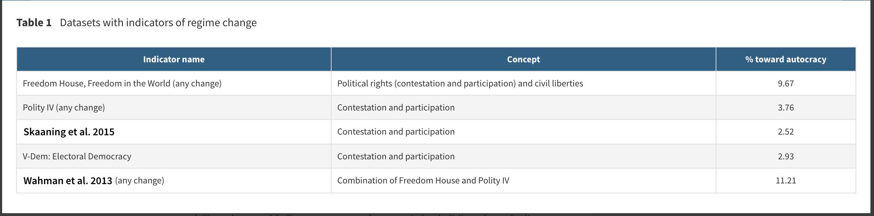
Competition II. Participation III. Answerability

Slide 8





Some Recommendations for defending democracies
FREEDOM HOUSE 2020 ‘FREEDOM IN THE WORLD’ REPORT
Emphasizing democracy strengthening programs in foreign assistance.
Focusing attention and funding on countries at critical junctures.
Supporting civil society and grassroots movements calling for democracy
Investing in alliances with other democracies, and in multilateral institutions.
Addressing impunity by imposing targeted sanctions on individuals and entities involved in human rights abuses and acts of corruption

Slide 9
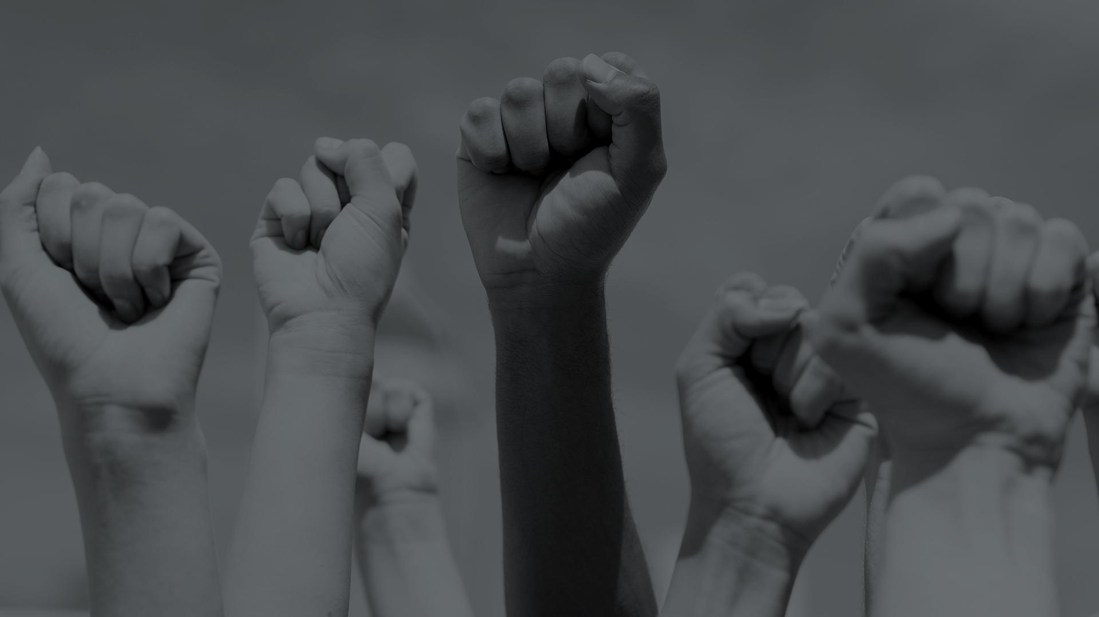
Questions
In context of Democratic Peace theory, should other democracies interfere covertly or overtly with other declining democracies?
Freedom house in its suggestions to promote democracy talks about supporting grassroots movements. Will bypassing state actors to support other actors, affect the stability of a democracy?

Slide 10
THANK YOU

